Slide 1
Our talk About D-Wave Hosted by Harrisburg University
by Alex Khan
July 21, 2020
All images belong to D-Wave Systems, Inc. or the appropriate copyright owners

Slide 2
Topics
Spin in superconducting circuit SQUID
Annealing QPU
QUBIT Layout (Chimera Diagrams)
Equivalent Qubit interconnectivity
Minimizing Energy
Quantum Tunneling
Typical Energy Landscape

Slide 3
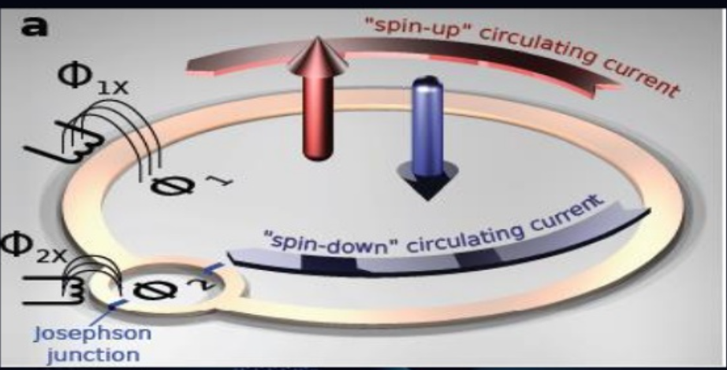
Spin in superconducting circuit SQUID

Slide 4
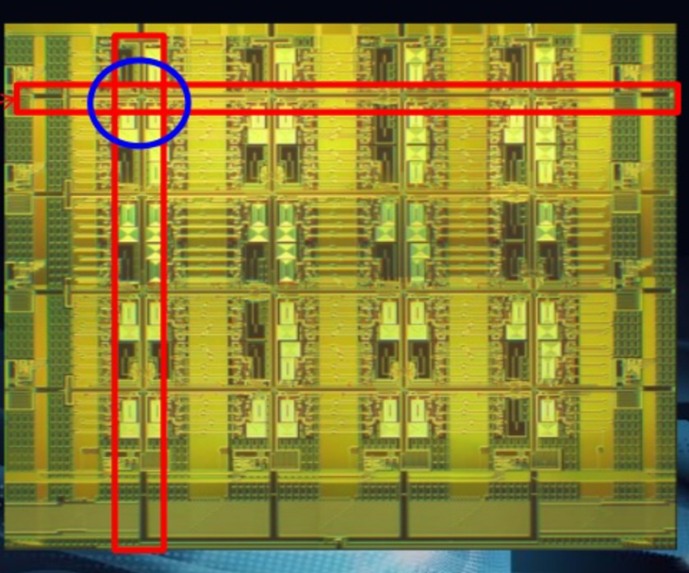
Annealing QPU (D-Wave)
Coupling
Between
qubits
Qubits

Slide 5
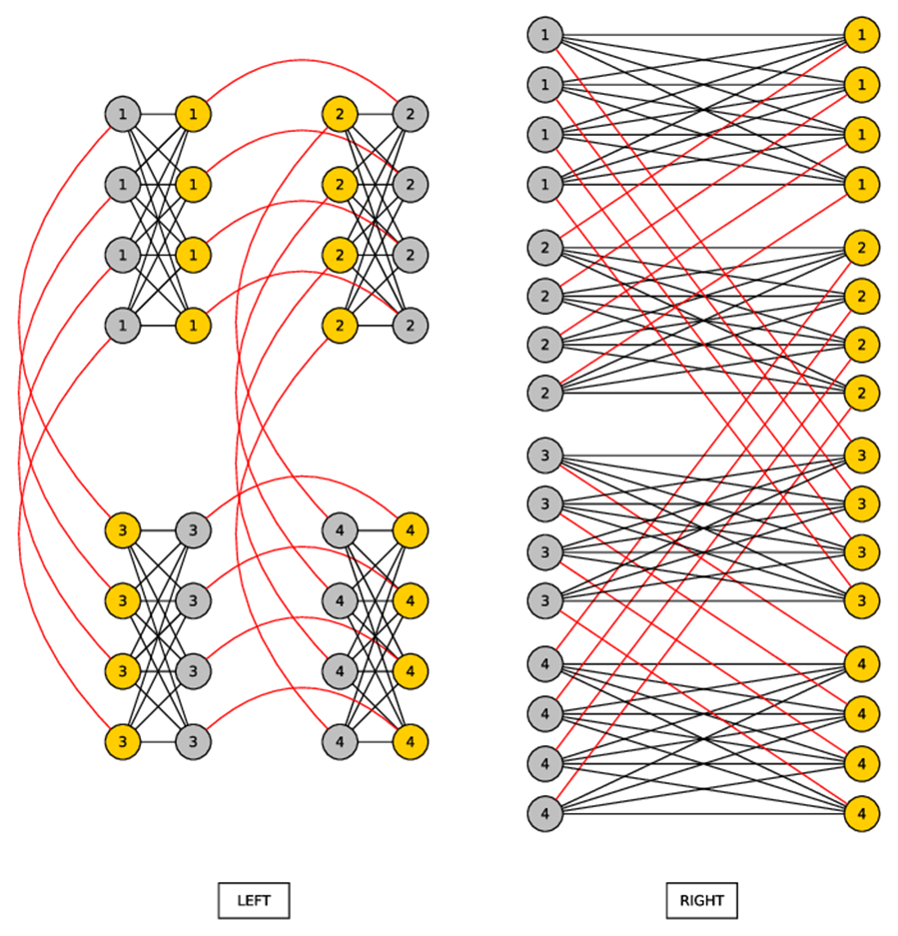
QUBIT layout (Chimera Diagrams)

Slide 6
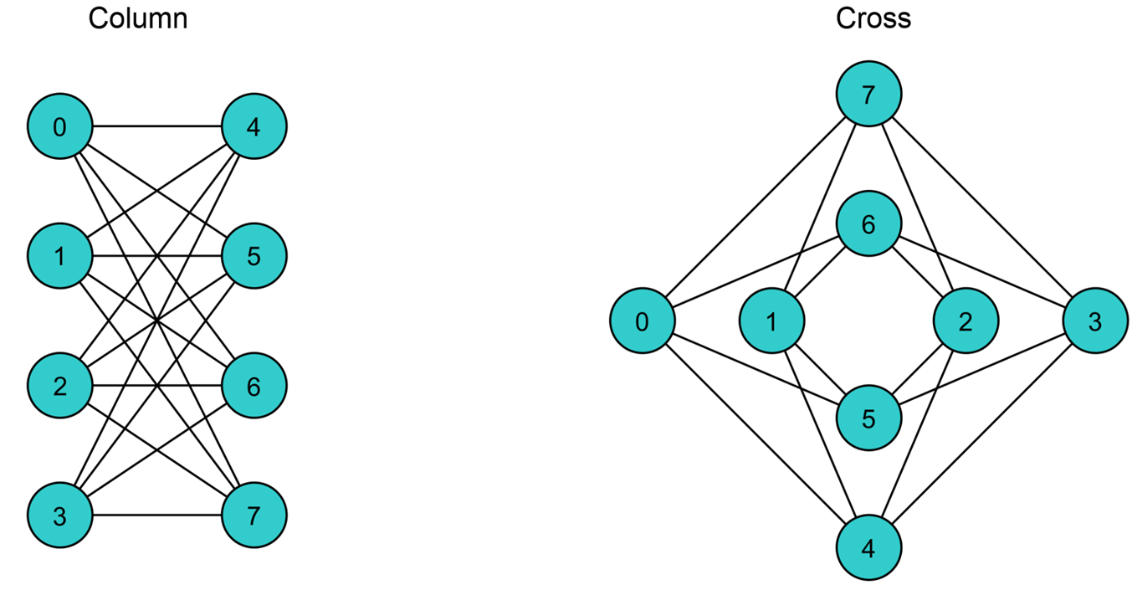
Equivalent Qubit interconnectivity

Slide 7
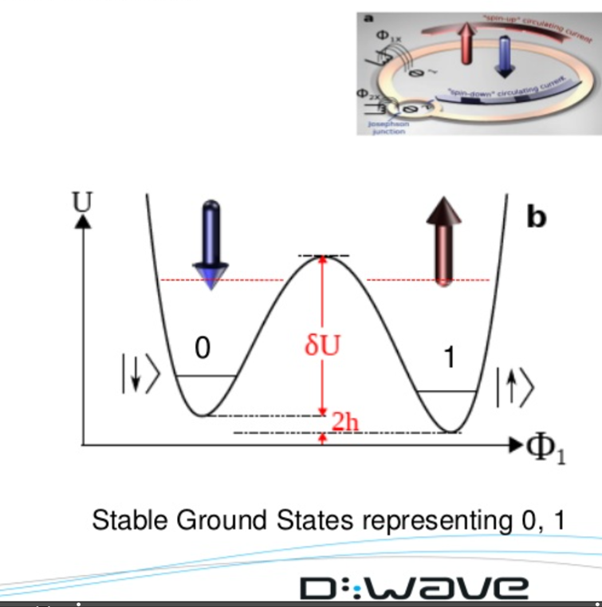
Minimizing Energy of Spins

Slide 8
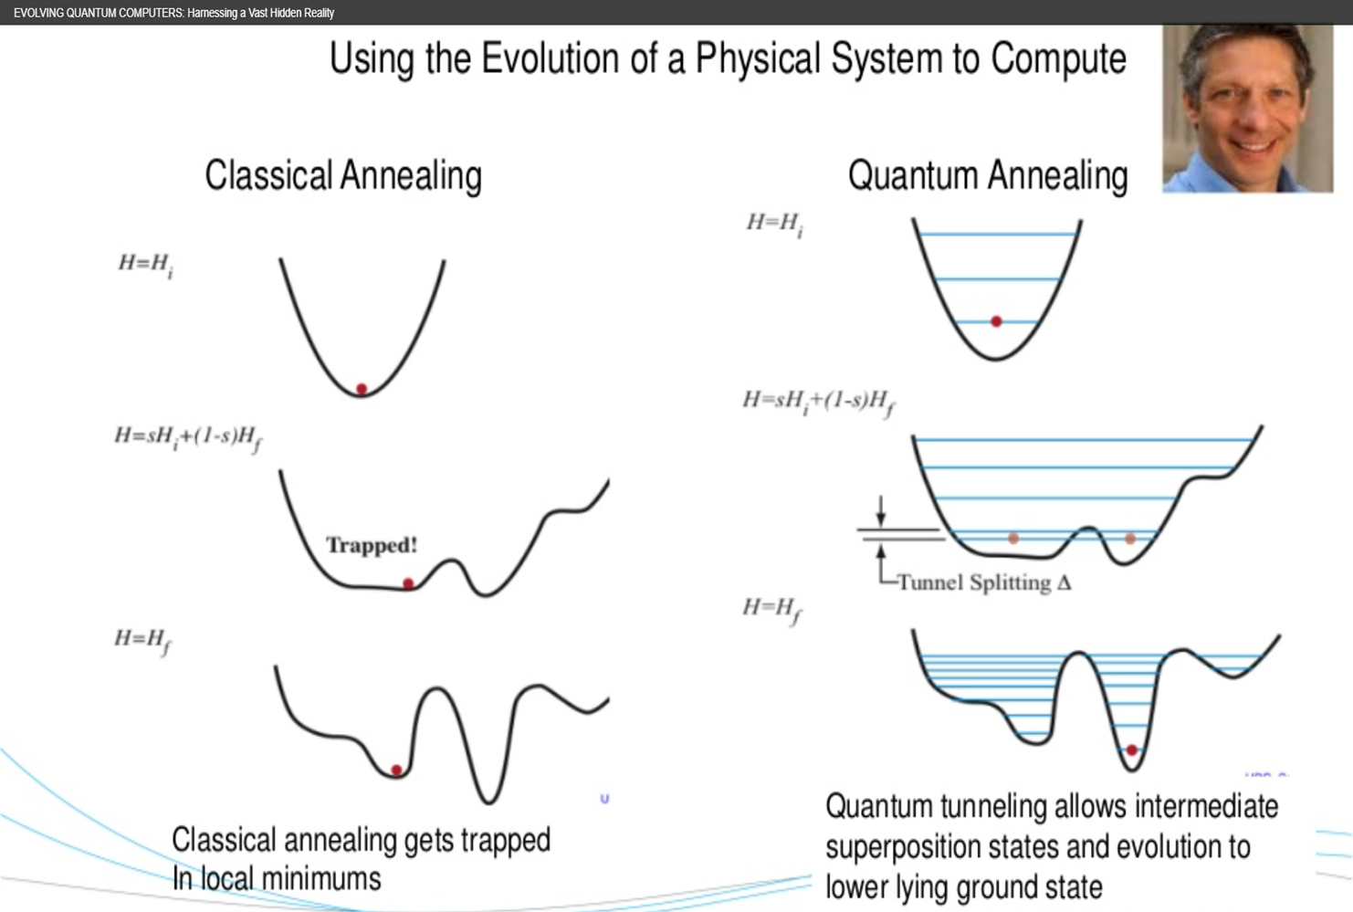
Quantum Tunneling

Slide 9
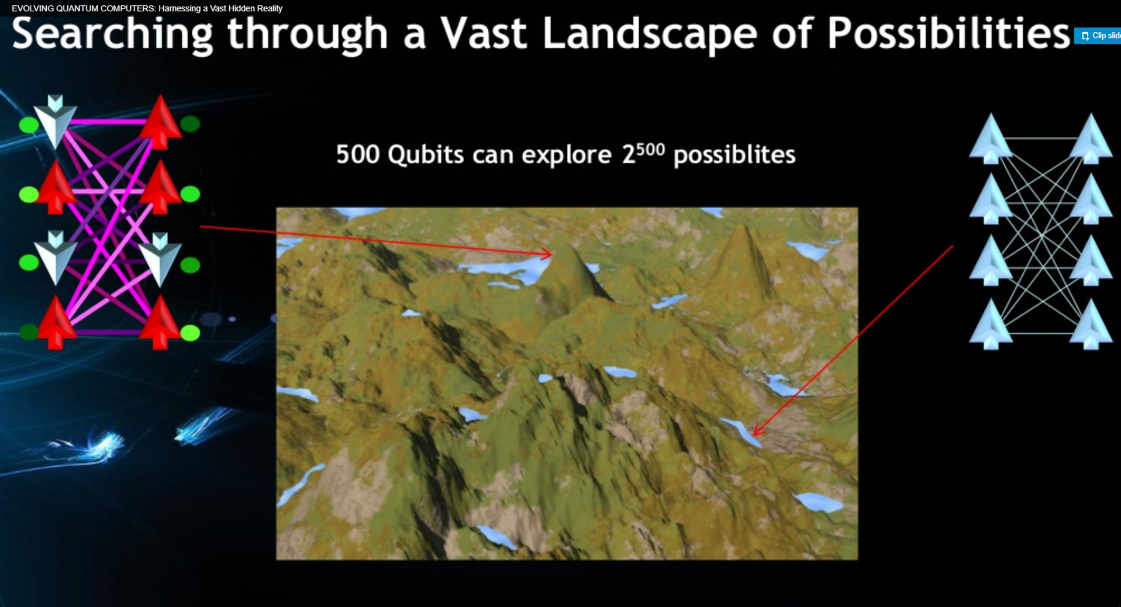
Typical Energy Landscape

